Slide 1


APPLIED DATA SCIENCE
Sowmiya Sakthivel
VVCET

Slide 2

CREDIT CARD FRAUD DEDECTION
INTRODUCTION
PROBLEM DEFINITION
DEEP LEARING
REAL-TIME MONITORING
IMPLANCED DATA HANDLING
DISCRIPTIVE ANALYSIST
ANOMALY DETECTION
PREDICTIVE ANALYSIST
NETWORK ANALYSIS
TIME SERIES ANALYSIS
CONCLUSION
This Photo by Unknown author is licensed under CC BY-NC-ND.

Slide 3

INTRODUCTION
Machine learning algorithms play a crucial role identifying fraudulent transactions by analyzing patterns and anomalies in credit card data.
Commonly used machine learning algorithms for credit card fraud detection include logistic regression, decision trees, random forests, and neural networks.
This Photo by Unknown author is licensed under CC BY-NC.

Slide 4

PROBLEM DEFINITION
The problem is to develop a machine learning-based system for
real-time credit card fraud detection.
The goal is to create a solution that can accurately identify fraudulent transactions
while minimizing false positives.
This project involves data preprocessing, feature engineering, model selection, training, and
evaluation to create a robust fraud detection systems

Slide 5
What the Credit Card Fraud Detection?
Credit card fraud is the act of using another person’s credit card to make purchases or request cash advances without the cardholder’s knowledge or consent.
These criminals may obtain the card itself through physical theft, though increasingly fraudsters are leveraging digital means to steal the credit card number and accompanying personal information to make illicit transactions

Slide 6
Types of credit card fraud
Credit card fraud falls into two basic categories:
1) Card present fraud
2) Card-not-present fraud

Slide 7

DIFFERENT ANALYSIS

Slide 8

Importing the required libraries(data.csv)
For credit card fraud detection, you would typically need libraries for data manipulation, visualization, and machine learning. Here are some common libraries that you might need:
pandas for data manipulation.
numpy for numerical operations.
matplotlib and seaborn for data visualization.
scikit-learn for machine learning tasks.
imbalanced-learn for handling imbalanced datasets, which is common in fraud detection.

Slide 9
import pandas as pd from sklearn.model_selection import train_test_split file_path = 'data.csv' data = pd.read_csv(file_path) data = pd.get_dummies(data, columns=['Category']) X = data.drop('Class', axis=1) y = data['Class'] X_train, X_test, y_train, y_test = train_test_split(X, y, test_size=0.2, random_state=42)
PROGRAM

Slide 10

Importing the data set(read data set;create matrix)
For credit card fraud detection, you typically have a dataset in a CSV format. You can import the dataset and create a matrix in Python using the pandas library to read the data and numpy to create a matrix. Here's a simple example:

Slide 11
import pandas as pd
import numpy as np
file_path = 'credit_card_data.csv'
data = pd.read_csv(file_path)
X = data.drop('Class', axis=1)
program

Slide 12

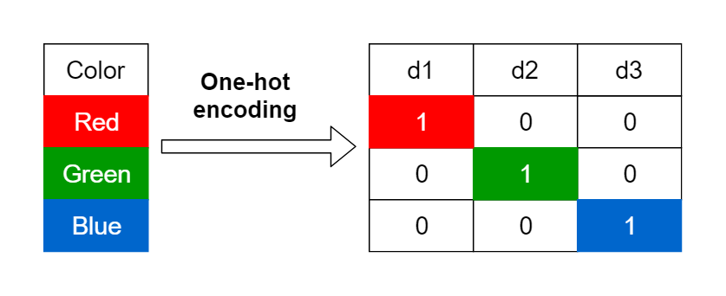
Encoding categorical data .(one - hot encoding)
To perform one-hot encoding for categorical data in a credit card fraud detection dataset, you can use the pandas
library. In this example, let's assume you have a column named 'Category' that contains categorical data, and you want to one-hot encode it:
This Photo by Unknown author is licensed under CC BY.

Slide 13
pip install scikit-learn import pandas as pd file_path = 'credit_card_data.csv' data = pd.read_csv(file_path) data = pd.get_dummies(data, columns=['Category'])
PROGRAM

Slide 14

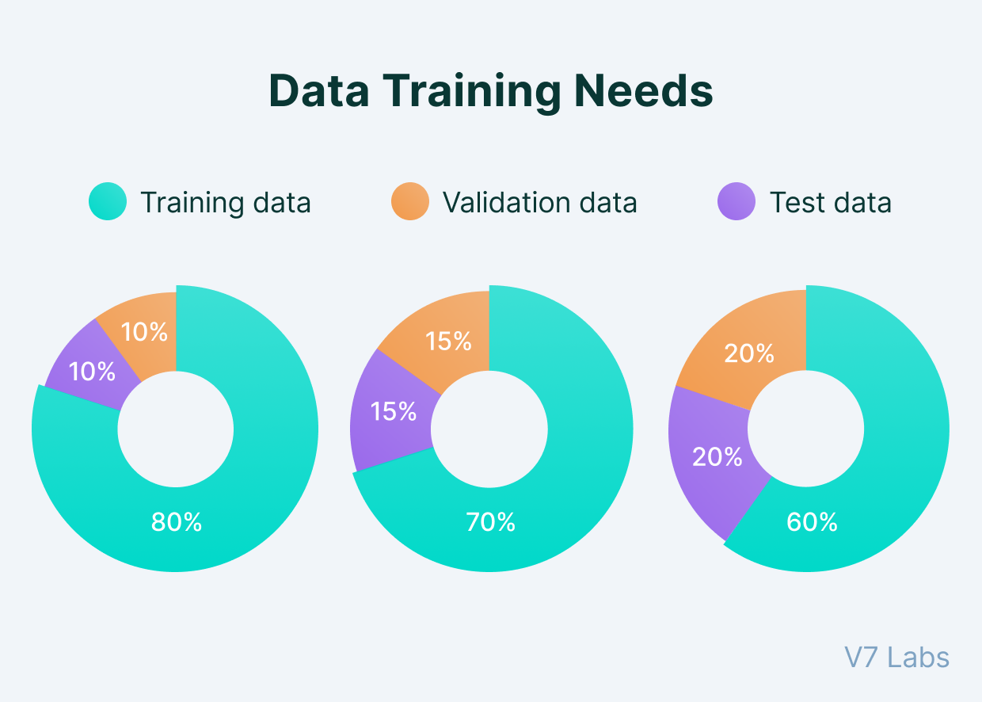
Splitting the data set into test set and training set
You can split your dataset into training and testing sets for credit card fraud detection using the train_test_split function from the scikit-learn library.

Slide 15
PROGRAM
import pandas as pd from sklearn.model_selection
import train_test_split
file_path = 'credit_card_data.csv'
data = pd.read_csv(file_path)
X = data.drop('Class', axis=1)
y = data['Class']
X_train, X_test, y_train, y_test = train_test_split(X, y, test_size=0.2, random_state=42)

Slide 16
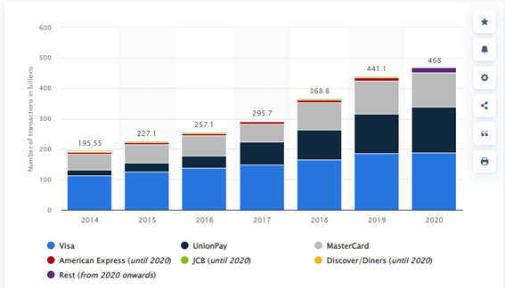
Feature Scaling.(import StandardScaler)
Feature scaling is an important preprocessing step in machine learning, including credit card fraud detection. You can use the StandardScaler from the scikit-learn library to scale your features.

Slide 17
import pandas as pd from sklearn.model_selection import train_test_split from sklearn.preprocessing import StandardScaler file_path = 'credit_card_data.csv' data = pd.read_csv(file_path) X = data.drop('Class', axis=1) Features y = data['Class'] X_train, X_test, y_train, y_test = train_test_split(X, y, test_size=0.2, random_state=42)
Program

Slide 18

THANK YOU

